Slide 1
Mid-Semester Presentation:
Bill Splitter
Team 2: Will Trimble, Glenn Todd, Ryan Yocum, Joe Wesnofske

Slide 2
System Concept Statement
Marketed toward college students
Users can scan receipt
Cost broken down fairly
Can assign item's cost to specific person
Will help with splitting and prevent paying unfair amounts
Prevent errors in splitting bills
Once finished, can send individual requests to pay back
Integrated with multiple apps (Venmo, Cash App, PayPal)
Will create a better user experience by being simple to use and having a sense of fairness

Slide 3
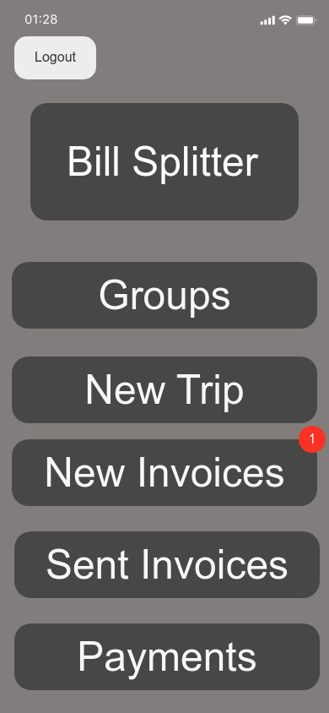
Walkthroughs
Notes:
Need Past Invoices
Want Persistent Home Button

Slide 4
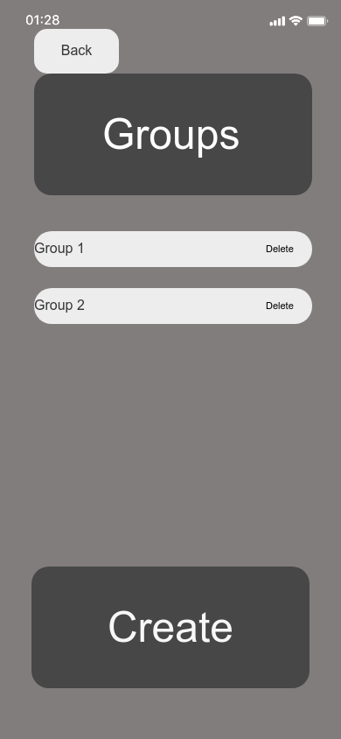

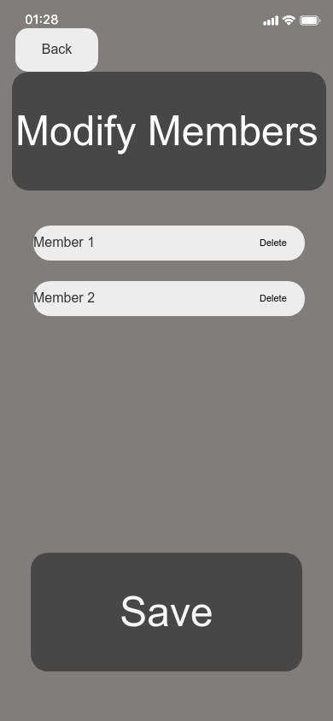

Group Formation
Notes:
Need Vanishing Groups

Slide 5
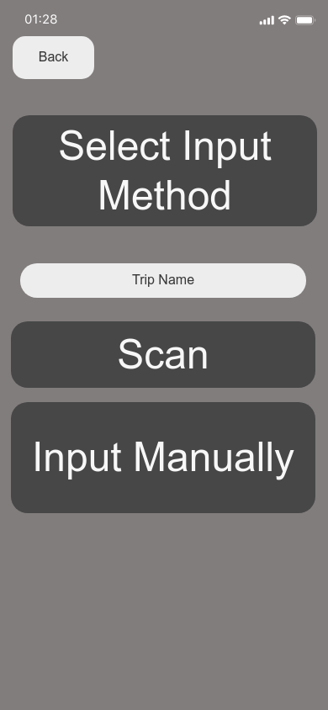

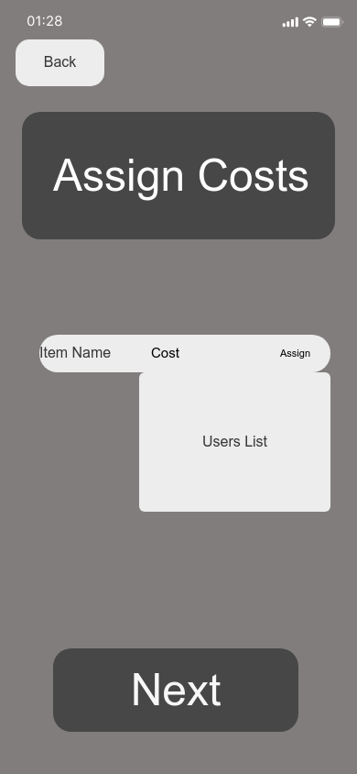
Scan Receipt

Slide 6
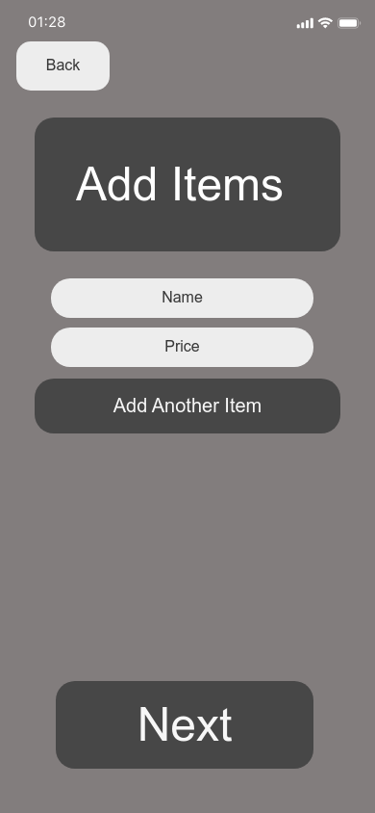
Manually Input Items
Notes:
Will

Slide 7
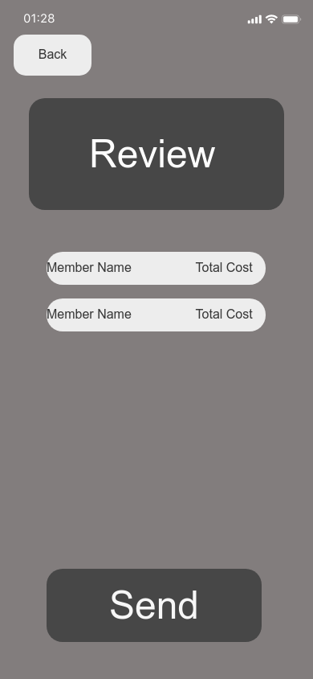
Assign Items
Notes:
Assign Percentage

Slide 8
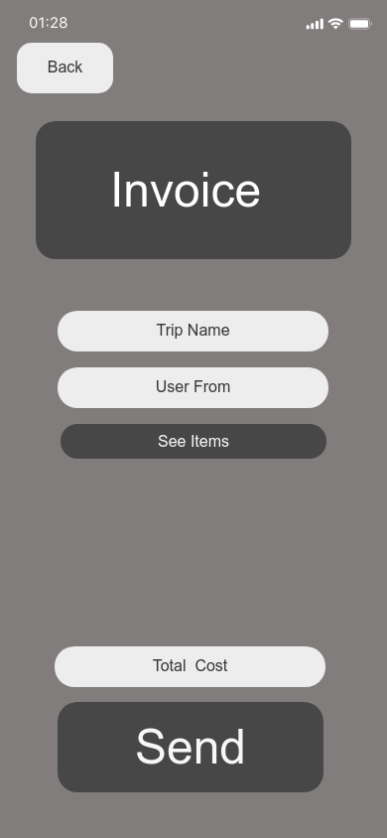
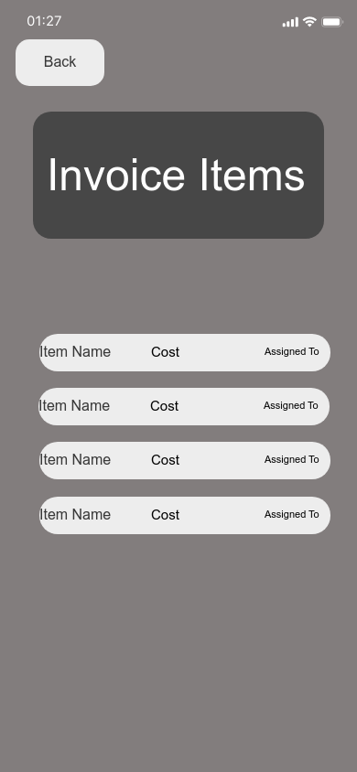
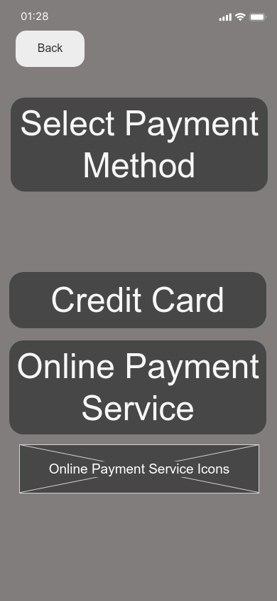
Pay Invoice

Slide 9
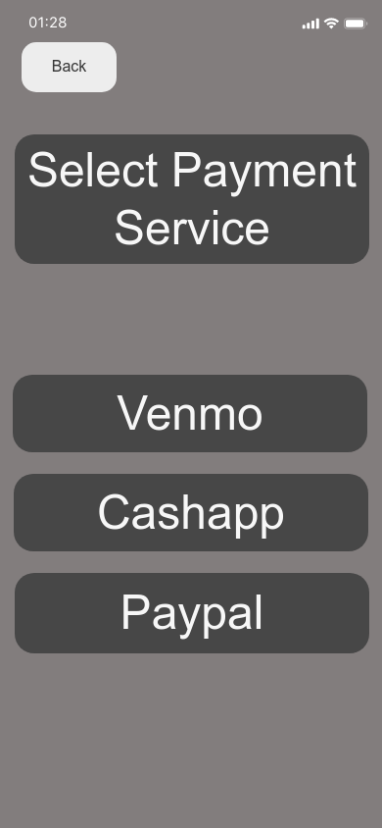
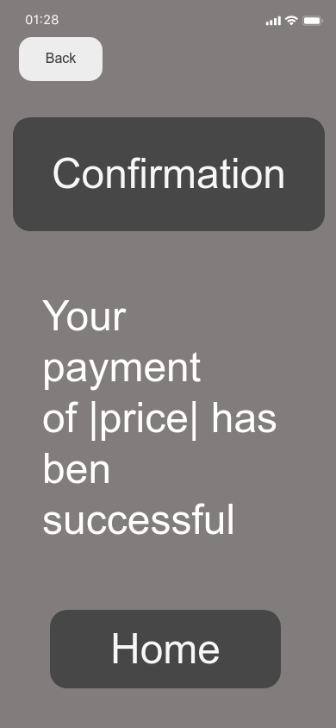
Pay Invoice
Notes:
Consider Failover State
Consider Partial Payments

